Slide 1
Mississippi Medicaid:
Telligen Provider Portal Training – Psychiatric Residential Treatment Facility (PRTF)
February 2025

Slide 2
Housekeeping
▪ Questions
Please enter all questions into the chat
Time during the training will be reserved for questions
Any unanswered questions will be answered and posted to the website
▪ Content availability
Presentation will be posted to the website following the training
Website: https://msmedicaid.telligen.com/
Located under Education/Training
All registrants will be sent a Survey via email following today’s training. Telligen welcomes your feedback and suggestions on future training opportunities.
Survey

Slide 3
Agenda
Purpose of Presentation
Contact Information
Review Timings Overview
Review Types Overview
Verifying Eligibility & Entering Physician Information
InterQual
Appeals & Denials
Helpful Links
Care Management
Questions

Slide 4
Purpose of the Presentation
The purpose of this presentation is to:
Troubleshoot authorization submission issues.
Enhance Navigation Skills in Qualitrac platform effectively.
Educate Providers on processes related to review timings and InterQual guidelines.
For specific complaints or to provide feedback on the review process, please send your concerns through our Provider Help Desk via Email: msmedicaidum@telligen.com or
Toll-Free Phone: 855-625-7709

Slide 5
Contact Us
Education Manager – Primary Point of Contact
Program Manager
Charity A. Jones
AJae Devine
Website: https://msmedicaid.telligen.com/
Assistant Program Manager
Cassandra Bullock
Mississippi Call Center & Provider Help Desk
• Email: msmedicaidum@telligen.com
• Toll-Free Phone: 855-625-7709
• Fax: 800-524-5710
Portal Registration Questions
• Email: qtregistration@telligen.com
• Toll-Free Phone: (833) 610-1057

Slide 6
Review Timings

Slide 7
Review Timings
Prospective—This is a review timing that is submitted before any services start or before any type of inpatient stay. The requested start date must be in the future.
Concurrent—This is the first review submitted if services have started. The requested start date should be the day of the request or any day in the past. The services are still in progress and have not ended.
Retrospective—This review timing is submitted after all services have been provided. The start date and discharge/end date should both be prior to the request date.
The timing of a review in Qualitrac is determined by when the services are/were provided. A member’s eligibility does not impact review timing.

Slide 8
Continued Stay Reviews
A Continued Stay Review (CSR) is a request submitted to extend a patient's stay in a healthcare facility beyond the initial approved authorization period. It ensures that extended care is medically necessary and meets the required clinical criteria for continued hospitalization
Why is a Continued Stay Review Needed?
To ensure continuity of care for patients requiring additional inpatient treatment.
To provide medical justification for extended stays based on clinical criteria and InterQual guidelines.
To maintain compliance with Mississippi Medicaid regulations and avoid claim denials due to lack of prior approval

Slide 9
Urgent Feature for Health Care Services
Service requiring emergent authorization due to the medical urgency determined by a treating healthcare professional familiar with beneficiary’s condition and could:
Seriously jeopardize the life or health of beneficiary
Subject beneficiary to severe pain that cannot be adequately managed without authorized approval of medical care
Lead to emergency medical condition if service is not rendered during a specific time
"Urgent health care service" does not include emergency services.

Slide 10
PRTF Mailboxes

Slide 11
PRTF Mailbox
Providers should use MSPRTF@telligen.com for sending monthly census and incident reports.
MSPRTF@telligen.com is the designated email address for sending reports.
Monthly Census Reports -Providers are required to email their monthly census reports to MSPRTF@telligen.com. These reports typically include information about the number of patients or individuals served within a specified period.
Serious Incident Reports-Providers should email any incident reports related to their facility or program to MSPRTF@telligen.com. Incident reports document any occurrences that may impact patients, staff, or operations.

Slide 12
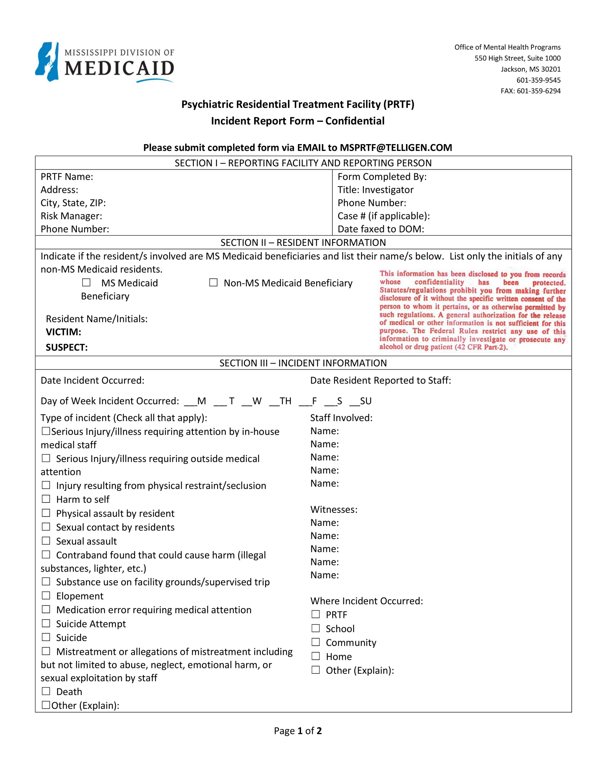
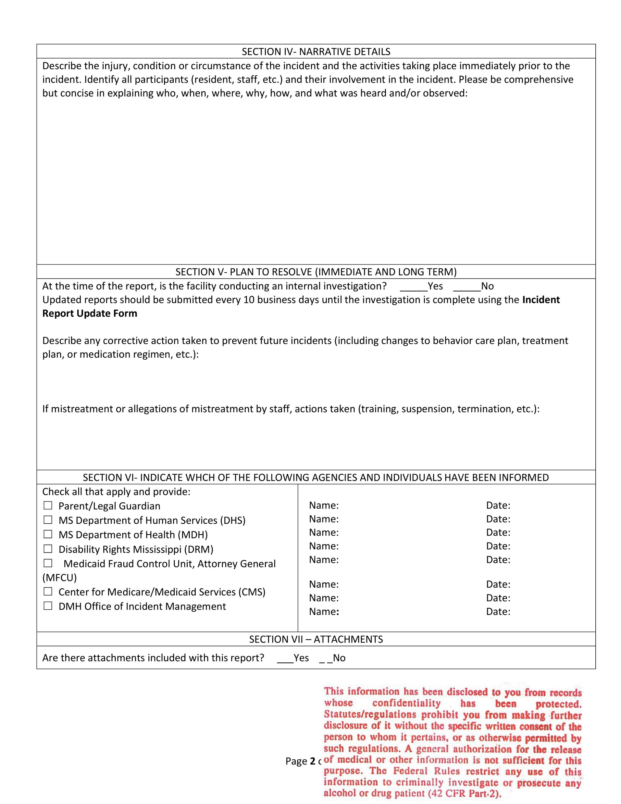
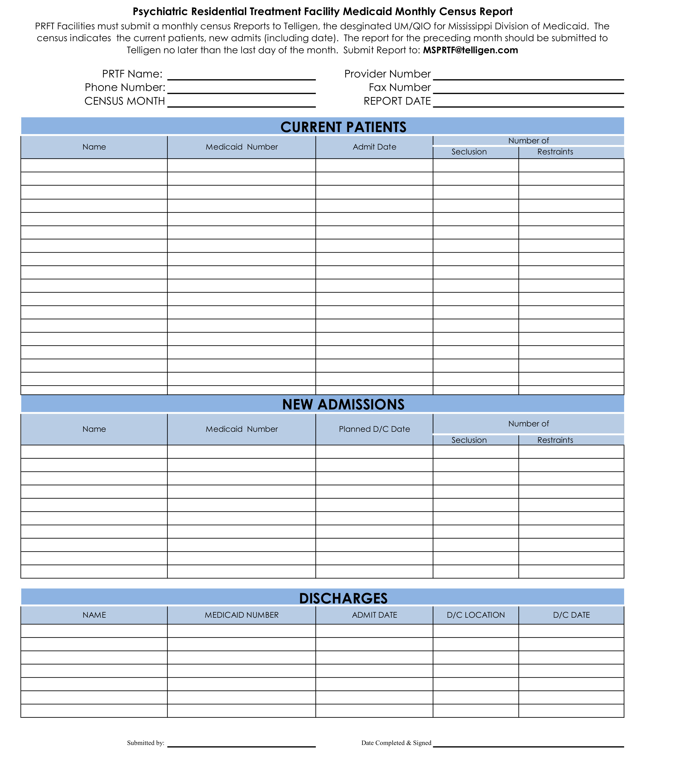
PRTF Monthly Census and Serious Incident Reports
Monthly Census Report
Serious Incident Reports

Slide 13
Submitting a Review

Slide 14
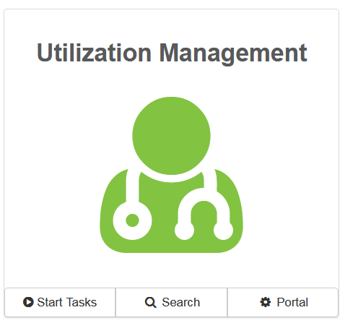
Telligen Provider Portal – Landing Page
Start Tasks will take you to the task queue to view any reviews where additional information has been requested
Search will allow you to search for a member or a case. Just like the magnifying glass at the top of the page.
Portal will take you to the portal or to the task queue.

Slide 15
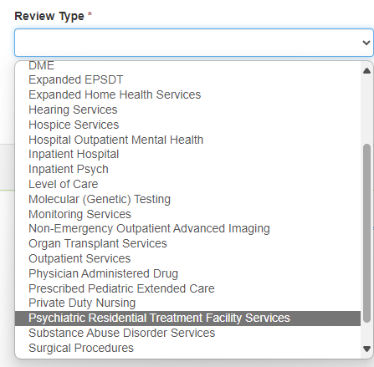
Authorization Request Panel- Review Type
Enter the Review Type: This is where you will select the type of review you are requesting:
Psychiatric Residential Treatment Facility Services (PRTF)

Slide 16
Authorization Request Panel cont.
Place of Service: This is where you will select the place where care is being given.
Type of Service: This Is the type of service being requested.
Timing: This is where you will select Prospective, Concurrent or Retrospective
Select Add New Request to complete the process.
If the request was entered in error, you can select Cancel to remove the request
Notes:
Highlight the option of “community” is the most appropriate with the understanding the services may also be provided in the Home or Agency

Slide 17
Timings
Prospective – This is a review timing that is submitted prior to any services starting or before any type of inpatient stay. The requested start date must be in the future.
Concurrent – This is the first review that is submitted if services have started. The requested start date should be the day of the request.
Retrospective – This is a review timing that is submitted after all services have been provided. The start date and the discharge/end date should both be prior to the request date.

Slide 18
Admission and Discharge Panel
Once you select Add New Request, the page opens to fill in all the remaining information necessary to process the request.
Admission and Discharge is used to enter the Admission Date, Admission Type, and the Admission Source

Slide 19
Providers Panel: Physician and Provider Information
Providers: This section requires information related to who is ordering and providing the care:
Treating Physician – The person providing the care; this may or may not be a physician, i.e. Social Worker providing counseling
Treating Facility – The organization providing the care
Ordering Provider- The person or Organization ordering the care
click the Add button on each box to fill in the necessary provider information

Slide 20
Entering Physician and Facility Information
Clicking will open a search box. You can search by entering an NPI number, Medicaid ID, or by filling in any of the information boxes provided if the NPI is not known.
Once you have entered the necessary information, click search to locate the physician or facility you are looking for.
Use the green plus box next to the name to select the provider/facility that you need for the review. ​
Please pay close attention to select the Medicaid ID number
Please pay close attention to the name and location selected.
Example: Regional Services LLC vs Regional Care Services Inc. This is an important point because some providers have multiple locations under the same NPI and possibly similar name.

Slide 21
Diagnosis Panel
Diagnosis Panel: This is where you can enter the diagnosis information related to this review.
You will use the button to add a new diagnosis to the panel.
You can enter as many diagnoses as needed.
You do have the ability to reorder or prioritize the diagnoses using the drag and drop feature.
Notes:
Indicate this is a qualitrac required field and will not have a direct impact on the overall decision making by the reviewer. We understand that a diagnosis code is not required by the program.

Slide 22
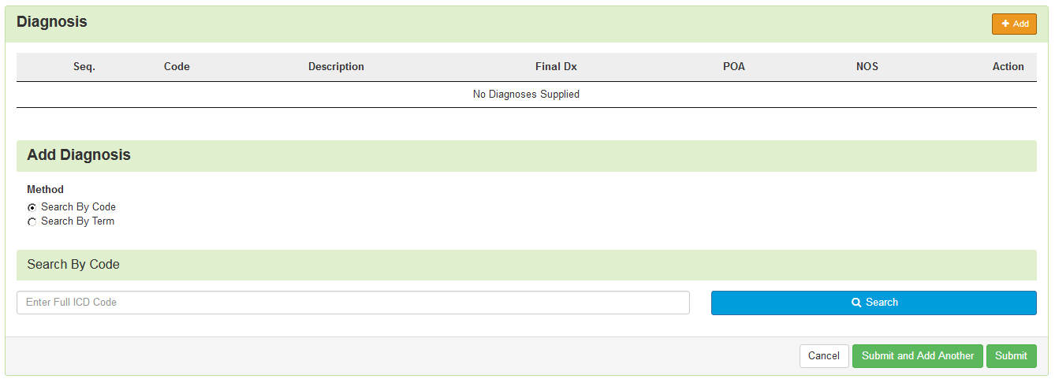
Diagnosis Panel cont.
Once you click , you will have the ability to search for a diagnosis either by Code or by Term.

Slide 23
Diagnosis Panel: Populating the Diagnosis
Entering a code:
Select method: Code or term to search (radio button to select)
Enter information in the search box
Click Search
The system will provide you a list of results you can select from. Select the one that you want added to the review by clicking on the radio button to the left of the code.

Slide 24
Diagnosis Panel cont.
After selecting the diagnosis you want added to the review, you can select Submit or Submit and Add Another.
Submit will add the diagnosis to the review.
Submit and Add Another will allow you to submit the diagnosis to the review and re-open the window where you can search for another diagnosis.
You can use the trash can icon on the right side of the diagnosis to delete anything entered incorrectly in this panel.

Slide 25
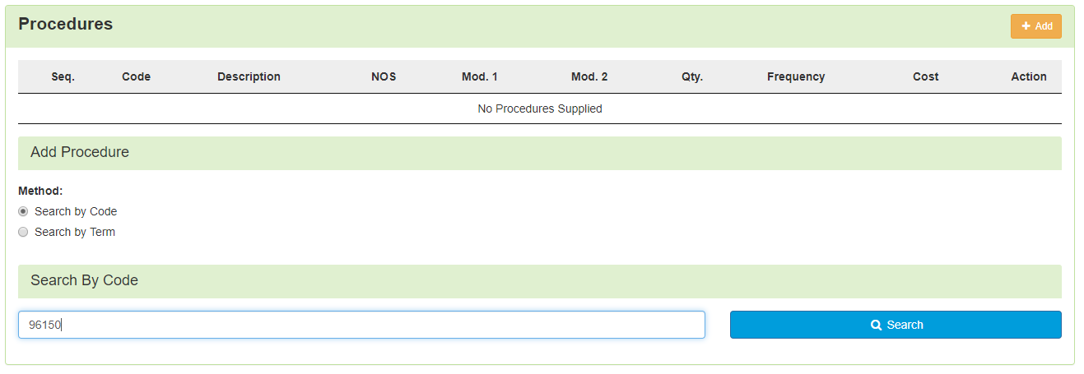
Procedure(s) Panel
The Procedures Panel is where the procedure code information related to this review is added.
Click the button to add a new procedure to the panel.
Select Radio button to indicate a code or term search
Enter information in the search box
Click search

Slide 26
Procedure(s) Panel cont.
The Term search allows for the user to search based on Section, category and sub-category if needed
Once Query has populated, Use the radio button to Select the correct Procedure(s) (99233-This is a default code and is needed only to move through the system).

Slide 27
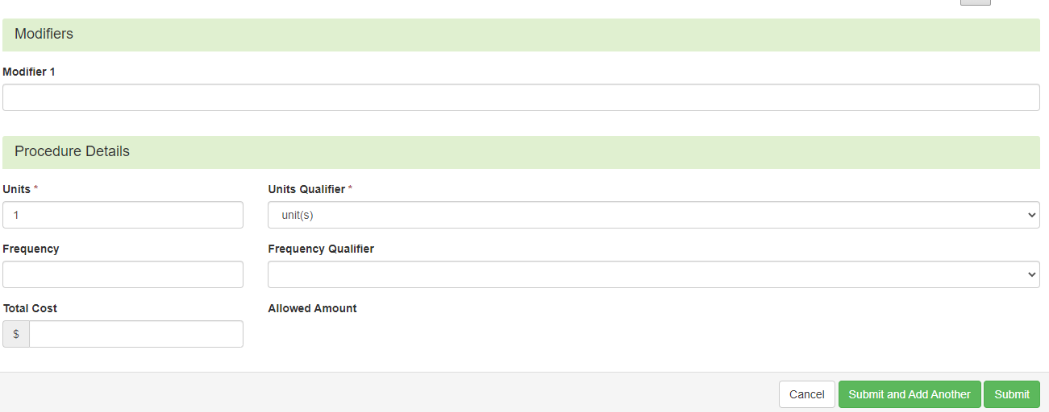
Procedure(s) Panel cont.
Complete Modifiers and procedure details as needed
After selecting the procedure(s) you want added to the review:
Submit will add the procedure to the review.
Submit and Add Another will allow you to submit the procedure to the review and re-open the window where you can search for another procedure
Enter as many procedures as needed.
Note: Modifiers are not required by the system, but PA should match what you expect to submit on your claim

Slide 28
Procedure(s) Panel cont.
Use the trash can icon on the right side of the procedure to delete anything entered incorrectly in this panel.
Prioritize the procedures using the drag and drop features.

Slide 29
Documentation Panel
Documentation Panel is the final panel on the page to submit the review.
This is where you can upload any clinical documentation related and necessary for the review to be processed.

Slide 30
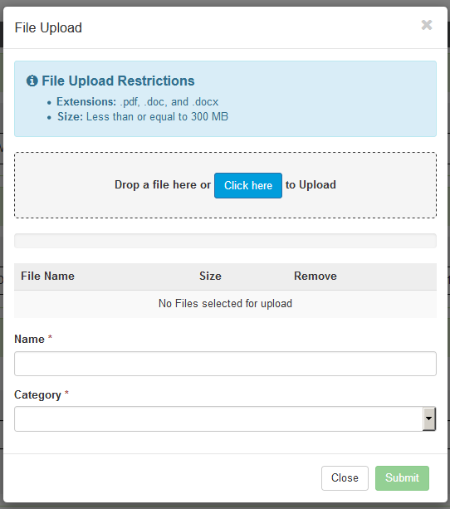
Documentation Panel cont.
To submit documentation, click the button on the Documentation Panel. This will open a modal where you can drag and drop files or select Click here to open a windows directory and find the necessary files.

Slide 31
Documentation Panel cont.
Please note:
Documents must be a .pdf or word document
The size is limited to 300MB per document.
Complete the File upload fields
Name:
The Name box allows you to name the file to what makes sense, if needed
The file name cannot have any spaces or special characters.

Slide 32
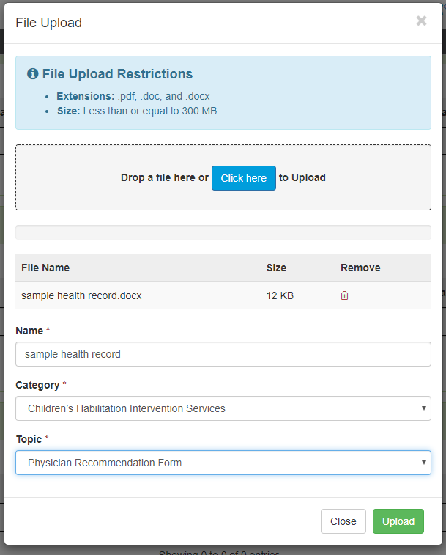
Documentation Panel cont.
Category:
select from the drop down the type of document that you are attaching.
Topic:
Select from the drop-down type of document being attached.
Click Upload to attach the information to the review.
NOTE: This can be repeated as many times as necessary to get all relevant documentation added.
Notes:
. Please verbally provide the list of available topics

Slide 33
Required Documentation
Psychological Diagnosis
Psychological/Psychiatric Evaluation (within 30 days of admission)
IQ test results (within 30 days of admission)
Statement of the need for residential treatment that is essential for safety, stabilization, and comprehensive treatment that cannot be adequately provided through outpatient or lower-level interventions
Residential treatment is recommended by a Psych physician.
Discharge Plan
Treatment Plan w/Goals
All documentation must include 2 patient identifiers
For example – patient name and Medicaid number or patient name and date of birth (DOB).

Slide 34
Assessments
This information should be completed for each beneficiary

Slide 35
Completing your Review
Once all the panels have been filled out, click Continue in the bottom right of the page to complete the review.

Slide 36
Criteria
The criteria being used is NOT changing at this time.
Telligen will be using InterQual criteria for the Mental Health reviews.
You will need to document against that criteria as part of your submission process.

Slide 37
InterQual Process
If there are clinical guidelines that apply, you will see the procedure or diagnosis with a Guideline Title line and the user will select the InterQual Action button to document which criteria are present.
Select all that are relevant and choose save once all information has been entered.

Slide 38
InterQual Process
InterQual is integrated into Qualitrac to provide transparency into the clinical guidelines and criteria we use to review your authorization requests
The system automatically takes the end user through the InterQual process

Slide 39
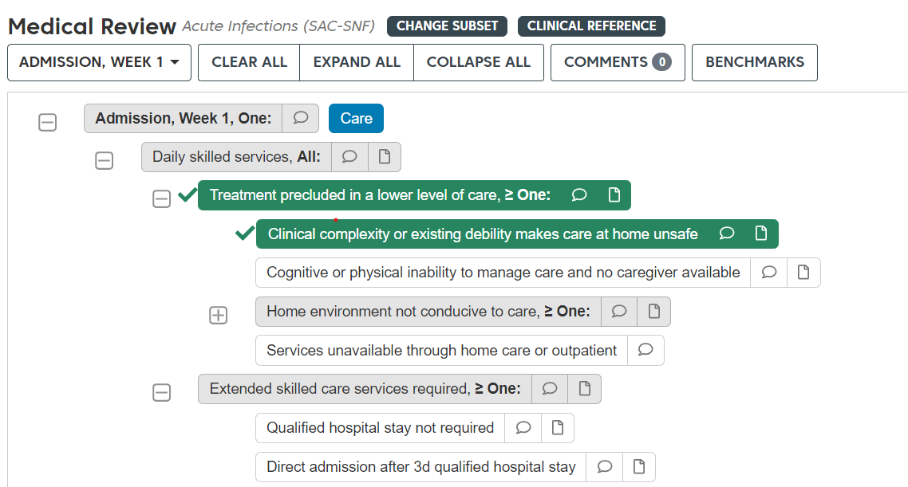
InterQual Process cont.
Select the guideline.
Click all criteria that apply.

Slide 40
InterQual Process cont.
Once all documentation is entered, click the Complete button to finish this section and return to finalizing the review.

Slide 41
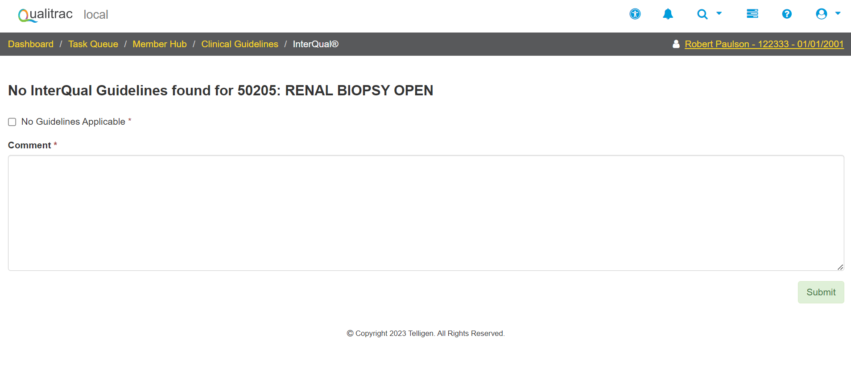
InterQual Process cont.
If there are no clinical guidelines that apply, you will be presented with a text box where clinical information relevant to the review can be entered.
Once all applicable data has been entered, click the submit button to finish the documentation.

Slide 42
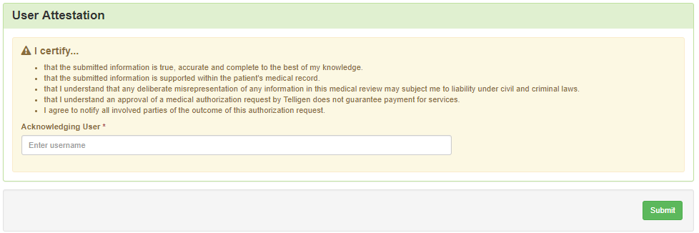
Attestation
The last piece of submission is to enter your Username in the attestation section
Click the Submit button to send the review to Telligen
If any information is missing, an error will indicate what is missing

Slide 43
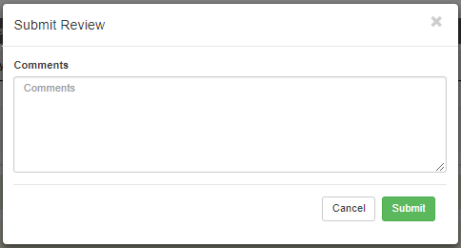
Comments
Users have the option to add comments to the review before it is sent to Telligen.
A comments modal will open, and the user can enter additional information related to the review.
This is not required to complete the review.

Slide 44
Summary
After submitting you will be taken to a summary of the review
Users will have the option to Edit or Delete via the button
To navigate off of the request, scroll to the bottom of the page and select
This will return the user to the tasks page where you can begin a new search and submit other reviews.

Slide 45
Where Did My Review Go?
Once a review has been submitted, you can find the review by:
searching for the Case ID
searching for the member and looking at the UM panel in the Member Hub.
Member Hub functions:
Allows the user to look at the Review to check for determination and any correspondence
Submit a Reconsideration which is titled 1st Level Appeal
Delete a review that was submitted incorrectly

Slide 46
Review
Once in the UM Panel:
Navigate to your request
Click on the ellipsis at the right side of the line request. This menu will allow you to view the request in more detail, submit a reconsideration (1st Level Appeal), and other options.

Slide 47
Request for Information (RFI)

Slide 48
Request for Information
When a reviewer needs additional clinical documentation to make a determination, the submitter will be notified that additional Information is needed.
Notification Methods:
Email to user that they have a request for more information
A task will populate in the Qualitrac system
User steps:
Log into Qualitrac
Proceed to scheduled tasks
Click on the ellipsis to the left of the page, to start the task.

Slide 49
A Note About Timeframes
Provider Timeframes
Providers have 10 business days to respond to a request for information (RFI).
Providers have 30 calendar days to submit a reconsideration.
Providers should enter reviews for urgent or emergent admissions on the next business day after the admission.
The Telligen portal is available 24/7/365, except for scheduled maintenance days.
Telligen Review Timeframes
Prospective | Concurrent | Retrospective
3 BD | 2 BD | 10 BD

Slide 50
Request for Information
Scroll down the summary page of the review
Proceed to the correspondence section.
Click on the blue name of the letter to open it and see what information is being requested.

Slide 51
Request for Information
Scroll up to the Documentation panel to attach additional information.
Click on the Add button to attach additional clinical documentation to the review.

Slide 52
Request for Additional Information
Once you add all necessary information, the system will trigger a task for the reviewer
Once you have added the additional information, the system will return you to the Scheduled tasks queue and the task will no longer be visible for the user.
**Do NOT start a new review to submit additional clinical information that was requested. This will delay the response. Please follow the steps outlined when a Request for Information task is available in the task queue.

Slide 53
Finding the Determination

Slide 54
Locating A Determination
To Locate the determination: Log in and select search under UM
Locate the member
Search for the case by using the case ID
Search by the member and locate the case in the member hub
Search Cases for the list of all auth requests
2
3
1

Slide 55
Locating A Determination
To Locate the determination:
If searching by the member, once in the member hub:
Scroll down to the Utilization Management section
Select the appropriate auth request (if multiple are present)
Click on the ellipsis on the right side of the page in line with the review you are searching for
Select View Request
If searching by Case ID
Upon selecting the case ID, you will be taken directly to the authorization request
If Searching by the case list, you will scroll to locate the case and select
Once the review is open, scroll down the page to the Outcomes panel
Click on the gray section of the panel to open it and view the details.

Slide 56
View Outcome

Slide 57
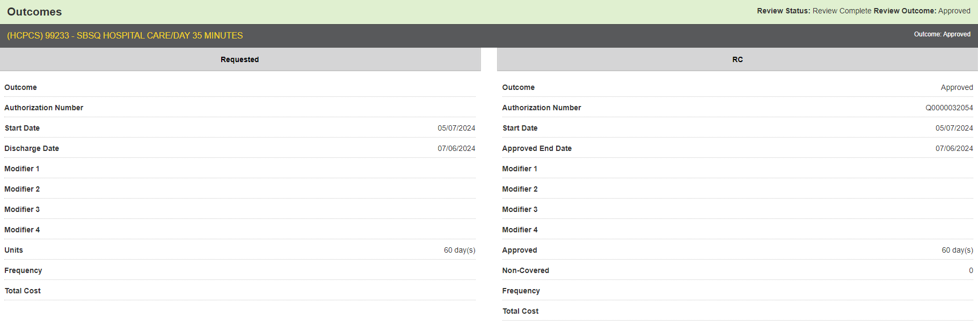
View Outcome

Slide 58
Submitting a Reconsideration
(1st Level Appeal) or P2P Review

Slide 59
Appeal Rights & Types
Right to Appeal: Providers and beneficiaries can appeal adverse determinations.
Timeframe: Appeals must be submitted within 30 days of date of determination outcome letter.
Types of Appeals:
Reconsideration (1st Level Appeal): Request from case and submit additional documentation in Qualitrac.
Peer-to-Peer Review: Discuss case with Telligen Physician.
Administrative Appeal: Appeal through the Division of Medicaid
Mailing address: 550 High Street, Suite 1000, Jackson, MS 39201

Slide 60
Submitting a Reconsideration (1st Level Appeal)
To submit a reconsideration for a denied review:
Go to the UM panel in the member hub
Click on the blue ellipsis within the denied case to open the action menu
Once there, select 1st Level Appeal from the menu.

Slide 61
Reconsideration (1st Level Appeal) cont.
The system will ask you if you are sure you want to submit a 1st Level appeal
Select the green button : Request 1st Level Appeal
You will still be able to delete the request later
Attach any additional documentation that is necessary to support the appeal

Slide 62
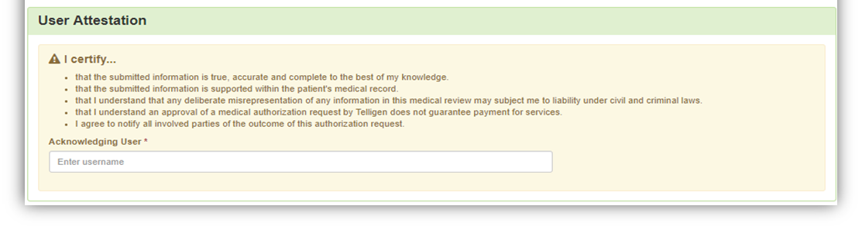
Reconsideration (1st Level Appeal) cont.
Sign the User Attestation using your USER ID
Click Submit to have the information sent to Telligen for reconsideration
The system will display your appeal

Slide 63
Discharge Information

Slide 64
Discharge Information Task
Discharge Information Task: For specific requests, a provider will receive a Discharge Information Task. This task will be shown in the scheduled task queue with the task type of “Discharge Status.” If the member has not been discharged and is still in the facility, the task does not need to be started until the discharge occurs.
If an extension of stay (CSR) is submitted, the task will be removed and a new task will be displayed once the Continue Stay Review has been completed.

Slide 65
Discharge Information
Starting the Discharge Task To submit a discharge for a review: 1. Users may start the task by clicking on the ellipses for the action menu and selecting “start” to be directed to the Authorization Request screen. Note: If the task has been started, but not completed, the action menu will display the option “Resume”.
Authorization Request Screen: Once the task is started(or resumed), the provider will see a limited view of the authorization request screen. The following information will be displayed: Authorization Request case information, Discharge, Diagnosis, and Documentation panels.

Slide 66
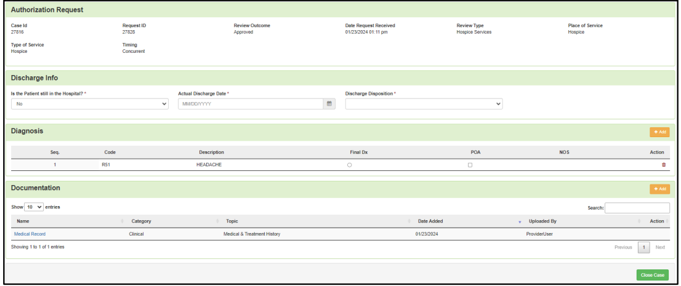
Discharge Information cont.
Discharge Panel: The user will be required to enter the following three pieces of information: indicate if the person is still in the facility, enter the actual Discharge Date, and enter the Discharge Disposition.
Diagnosis Panel: The user can update the diagnosis of the member and indicate a Final Diagnosis by selecting the radio button under Final Diagnosis. It can stay the same as the original diagnosis.
Documentation Panel: The documentation panel is where a user will upload any additional information such as the Hospice Discharge Form.
Completing the Task: Once all the information has been entered in the panels, the user can complete the process by clicking the “Close Case” button at the bottom of the page.

Slide 67
E-mail Notifications
Users will receive email notifications when:
Reviews are received from the portal
Reviews are updated/changed in status
To make sure that everyone in your organization that should receive email notification for reviews does get one, please select the organization or facility in the Provider Organization Visibility panel.

Slide 68
Helpful Links
Contact Information
Survey
Q&A

Slide 69
Helpful Tips
Helpful Links
Complete Documentation: Include comprehensive clinical details. Ensure all signatures are on required documentation
Effective Communication: If additional information is required, respond promptly via the portal under Request for Information (RFI) to prevent delays in approval.
Medicaid Provider Number: If you search with the Medicaid Provider Number, that will ensure you are selecting the correct doctor and location.
Education/Training
https://msmedicaid.telligen.com/education-training/
Document Library
https://msmedicaid.telligen.com/document-library/

Slide 70
Contact Us
Education Manager – Primary Point of Contact Program Manager
Charity A. Jones AJae Devine
Website: https://msmedicaid.telligen.com/
Mississippi Call Center & Provider Help Desk
Email: msmedicaidum@telligen.com
Toll-Free Phone: 855-625-7709
Fax: 800-524-5710
Portal Registration Questions
Email: qtregistration@telligen.com
Toll-Free Phone: (833) 610-1057
Assistant Program Manager
Cassandra Bullock

Slide 71
Survey
Thank you for attending the training! Your feedback will help us improve our sessions and address any additional needs you may have. Please take a few minutes to complete this survey.
https://forms.office.com/r/PcvKnkmqvK
Notes:
They can request for me or that the ticket be escalated to me in the tracking

Slide 72
Frequently Asked Questions
Q&A

Slide 73
Frequently Asked Questions-continued
Is there a change request option to add additional services to an existing approved request? Providers must submit a NEW request for additional services. There is a change request form available for updates to date changes, modifying quantities, or updating information. Updated form MS-Change-Request-Fill-In-Form.pdf (telligen.com)
When should I submit a retrospective request? Retro requests should be submitted when there is an eligibility change or a managed care recoupment affecting a prior authorization.
What documentation is required for a retro request? Providers must submit the following:
A formal authorization approval (e.g., approved CCO authorization or formal approval letter)
Proof of eligibility change (e.g., enrollment updates or CCO confirmation)
Proof of recoupments/denials (e.g., remittance advice or denied claim documentation)
Clinical documentation submitted with the original request

Slide 74
Frequently Asked Questions-continued
What is the purpose of the PRTF Monthly Census Report?
The report tracks new admissions, current census, and discharges to ensure accurate reporting of patient status and compliance with administrative code guidelines.
What information should be included in the Monthly Census Report? Providers must report:
Patient Name
Medicaid Number
Admission Date
Number of Seclusions and if reported to Telligen
Number of Restraints and if reported to Telligen
Discharge Location and Date (for discharged patients)
When is the Monthly Census Report due? The report is due by the last business day of each month .
How do we submit the Monthly Census Report? Reports should be emailed to MSPRTF@telligen.com
What happens if my report is incomplete or late? A late or incomplete reports may result in follow-up requests from Telligen and or DOM. Ensure timely and accurate submissions to avoid compliance issues.

Slide 75
Questions
?

